Slide 1
Christian Boot Camp
Basic Training
Spiritual Formation
Assessment

Slide 2
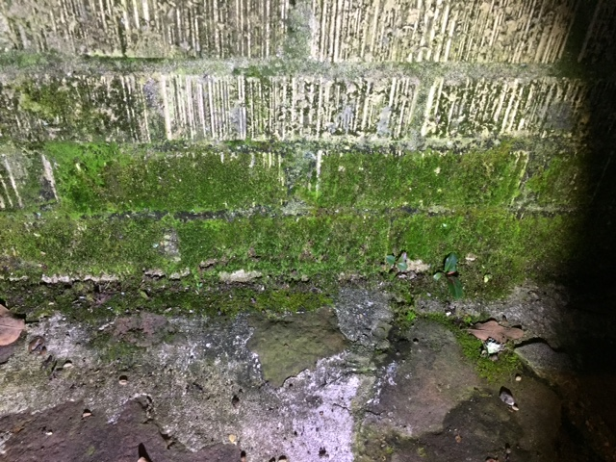

Slide 4
“Therefore let us leave the elementary teachings about Christ and go on to maturity, . . . “ Hebrews 6:1

Slide 5
“Like newborn babies,
crave pure spiritual milk,
so that by it you may
grow up in your salvation, . . . “
1 Peter 2:2

Slide 6
“Not that I have already obtained all this, or have already arrived at my goal, but I press on”
Phil[p 3:12

Slide 7
“as your faith continues to grow”
2 Cor. 10:5

Slide 8
Spiritual Formation
Assessment

Slide 9
1. Prayer

Slide 10
2. Scripture Reading

Slide 11
3. Attend Church

Slide 12
4. Serving

Slide 13
5. Christian Witness

Slide 15
6. Giving

Slide 16
7. Connecting in Small Group

Slide 17
8. Sabbath Rest

Slide 18
“At the end of your life you will groan . . .
You will say, “How I hated discipline! How my heart spurned correction!
I would not obey my teachers or
turn my ear to my instructors.”
Proverbs 5:11-13

Slide 19
"Jesus replied: “‘Love the Lord your God with all your heart and with all your soul and with all your mind.’ This is the first and greatest commandment. And the second is like it: ‘Love your neighbor as yourself.’ All the Law and the Prophets hang on these
two commandments.”
Mt. 22:37-40

Slide 20
“But seek first his kingdom
and his righteousness,
and all these things
will be given to you as well.”
Matthew 6:33

Slide 21
“If you love me,
keep my commands."
“Anyone who loves me
will obey my teaching."
John 14:15, 23

Slide 22
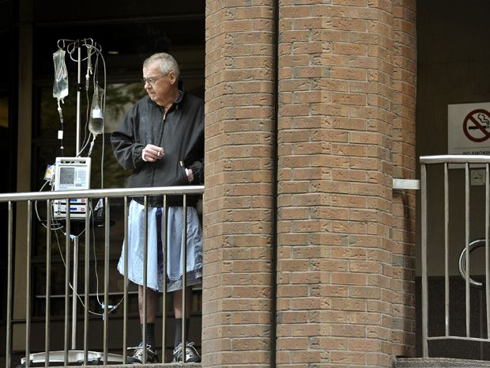

Slide 23
“But seek first his kingdom
and his righteousness,
and all these things
will be given to you as well.”
Matthew 6:33

