Slide 1
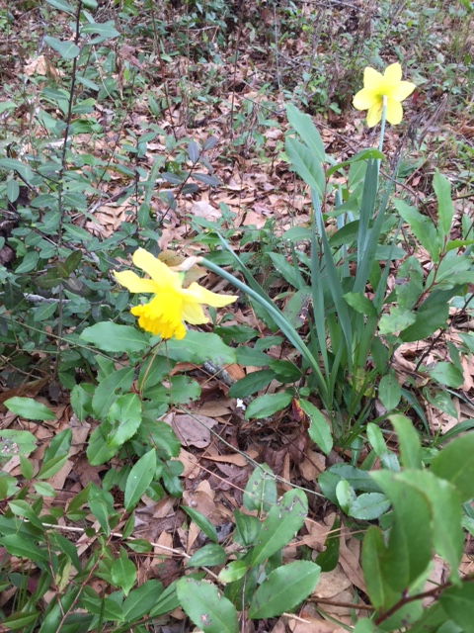

Slide 2
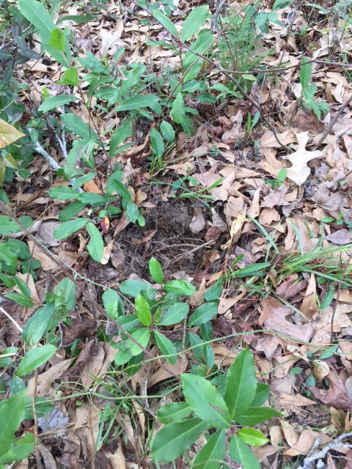

Slide 3
Who Is
This Man
Called Jesus?

Slide 4
“The time has come
The Kingdom of God
is near
Repent and believe
the good news!”
Mark 1:15

Slide 5
“Come, follow me,
and I will send you out
to fish for people.”
Mark 1:17

Slide 6
“What do you want with us,
Jesus of Nazareth?
Have you come
to destroy us?
I know who you are –
The Holy One of God!”
Mark 1:24

Slide 7
“Be quiet!”
“Come out of him!”
Mark 1:25

Slide 8
“The people were amazed at his teaching, because he taught them as one who had authority.”
Mark 1:22

Slide 9
What is this?
A new teaching –
and with authority!
He even gives orders
to impure spirits and
they obey him.”
Mark 1:27

Slide 10
“That evening after sunset
the people brought to
Jesus all the sick and
demon-possessed.
The whole town gathered
at the door, . . . “
Mark 1:32-33

Slide 11
Who Is
This Man
Called Jesus?

Slide 12
“The beginning of the
good news about
Jesus the Messiah,
the Son of God, . . . “
Mark 1:1

Slide 13
“And let us run
with perseverance
the race marked out for us,
fixing our eyes on Jesus,
the pioneer and perfecter
of faith.”
Hebrews 12:1-2

Slide 14
“Anyone who has seen me
has seen the Father.”
John 14:9

Slide 15
“I have come that
they may have life,
and have it to the full.”
John 10:10

Slide 16
Who Is
This Man
Called Jesus?

